Slide 1

Comparison And Analysis of Various Popular Convolutional Neural Networks on Object Classification
Group Members：
Zeyu Zhang zz2941
Chang Gao cg3320
Yazhe Yan yy3177

Slide 2
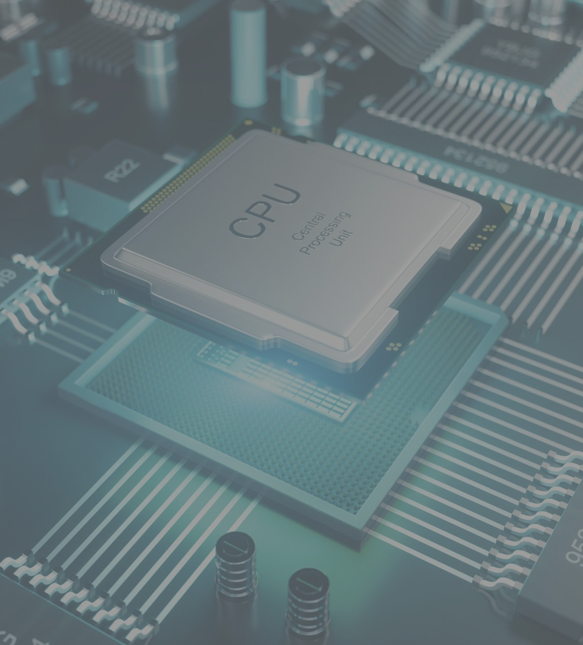
01
Introduction
OVERVIEW
02
Data
02
02
03
VGG
03
04
GoogLeNet
05
ResNet
06
DenseNet
07
Conclusion
Notes:
公众号：陈西设计之家。微信搜索即可。更多免费开源PPT模版以及教程源文件可以在公众内无条件领取。

Slide 3
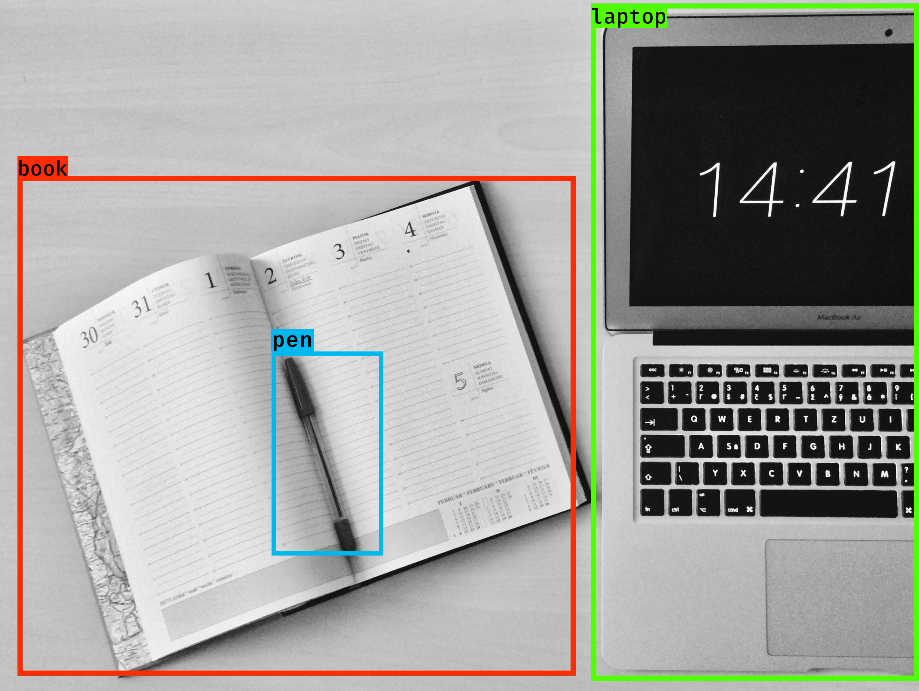
Introduction
Recently, deep learning has outperformed traditional machine learning techniques in the field of computer vision. For traditional image classification methods, the huge amount of image data is difficult to handle and cannot meet the operational accuracy and speed requirements of image classification. However, deep learning-based image classification methods break through this bottleneck and become the mainstream method to accomplish these classification tasks.
In this project, we used the PyTorch deep learning framework to classify images in six major categories: people, animals, plants, vehicles, fast food, and buildings. We plan to use four different popular deep learning models (ResNet, DenseNet, VGG, GoogLeNet) for this classification task and compare the performance of these models. At the same time, we hope to use a transfer learning method to adjust the trained and mature model to improve the accuracy of the model for this target.

Slide 4
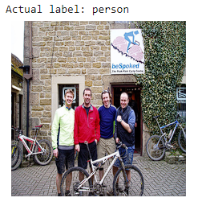
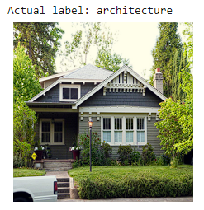
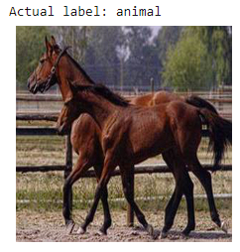
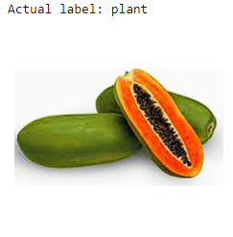
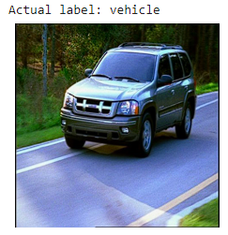
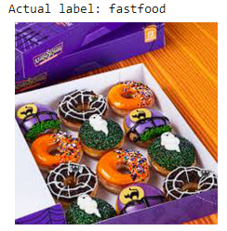
Data collecting and preprocessing
Since most of the CNN architecture emphasis on the deep learning nature, it requires significant amount of training data to build the model with contains substantial parameters. Collecting and labeling proper images could be very labor intensive given the size that it is dealing with. Fortunately, there are several open-source computer vision datasets that could be utilized to extract enough data for our training purpose.
We choose ImageNet2017, CIFAR-10 and some data sets from Kaggle, these open access image data sets, as our data source.
All the data are randomly selected from their respective classifications. For the preprocessing process, we have carried out appropriate processing methods for the images according to the respective selected CNNs.
All the data are randomly selected from the respective categories, and for the preprocessing process, we performed appropriate processing on the images, such as resizing and normalization, for the respective CNN of choice.
collected dataset

Slide 5
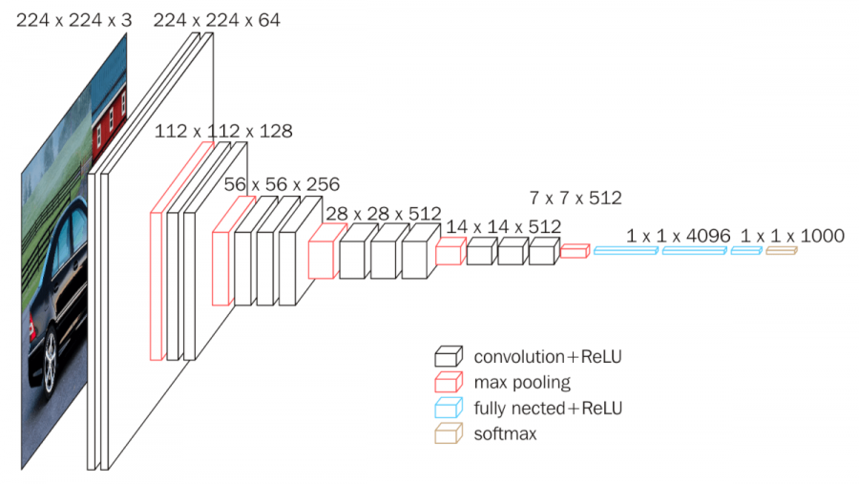
VGG
The full name of VGG is the Visual Geometry Group, which can be applied to face recognition and image classification.
VGG Structure diagram

Slide 6
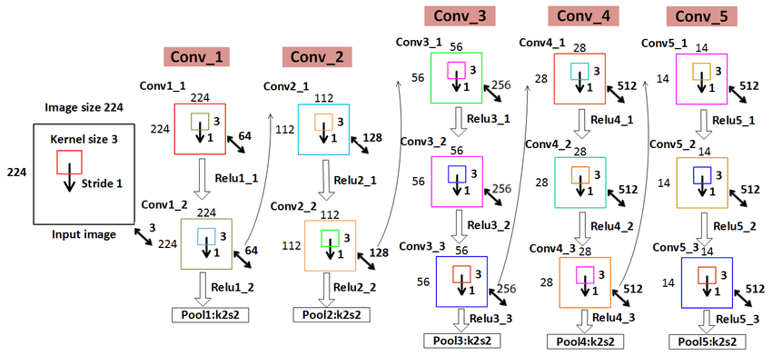
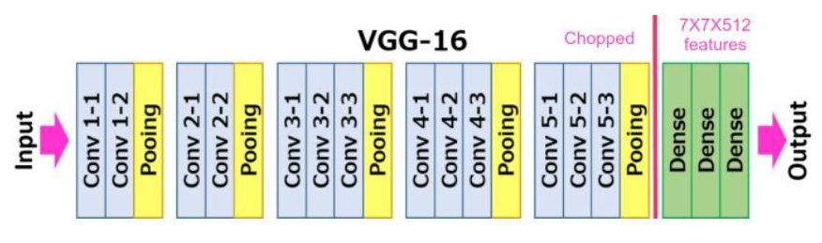
VGG
VGG-16 mainly has three parts: Convolution, Pooling, and Fully Connected Layers.
Convolution layer: In this layer, filters are applied to extract features from images. The most important parameters are the size of the kernel and stride.
Pooling layer: Its function is to reduce the spatial size to reduce the number of parameters and computation.
Fully Connected Layers: These are fully connected connections to the previous layers as in a simple neural network.
In VGG, the size of the convolution kernel is 3*3, the convolution step size is 1, the pooling kernel is 2*2, and the step size is 2. The most obvious improvement of VGG is to reduce the size of the convolution kernel and increase the number of convolution layers.
VGG Structure diagram

Slide 7
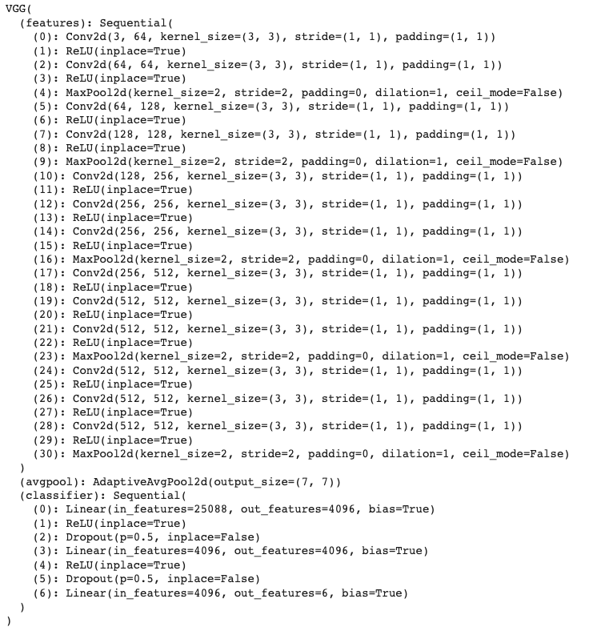
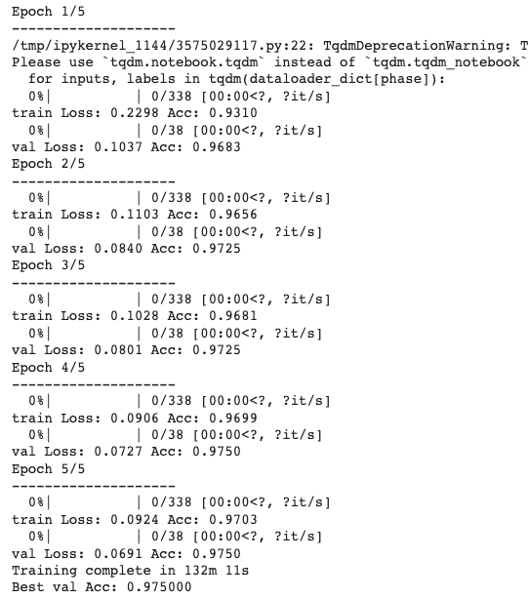
VGG
To perform transfer learning, we need to import a pre-trained model using PyTorch, remove the last fully connected layer or add an extra fully connected layer in the end as required(we can customize it to give a required number of outputs) and run the model.

Slide 8
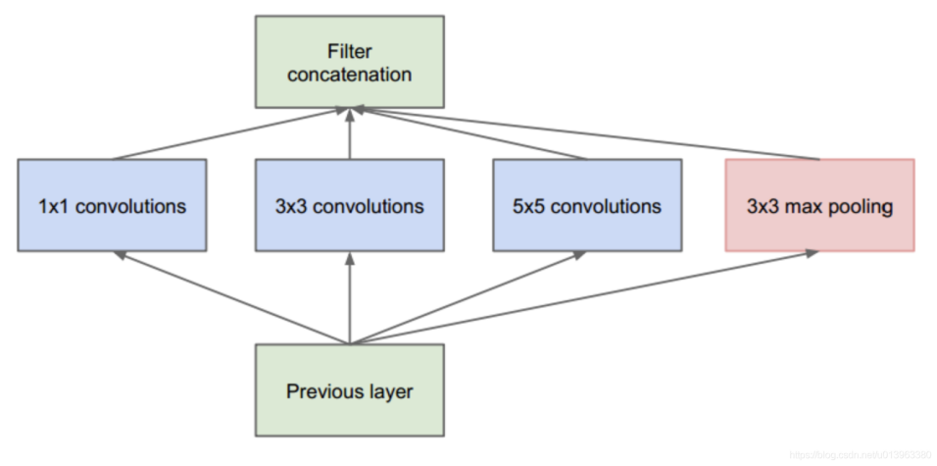
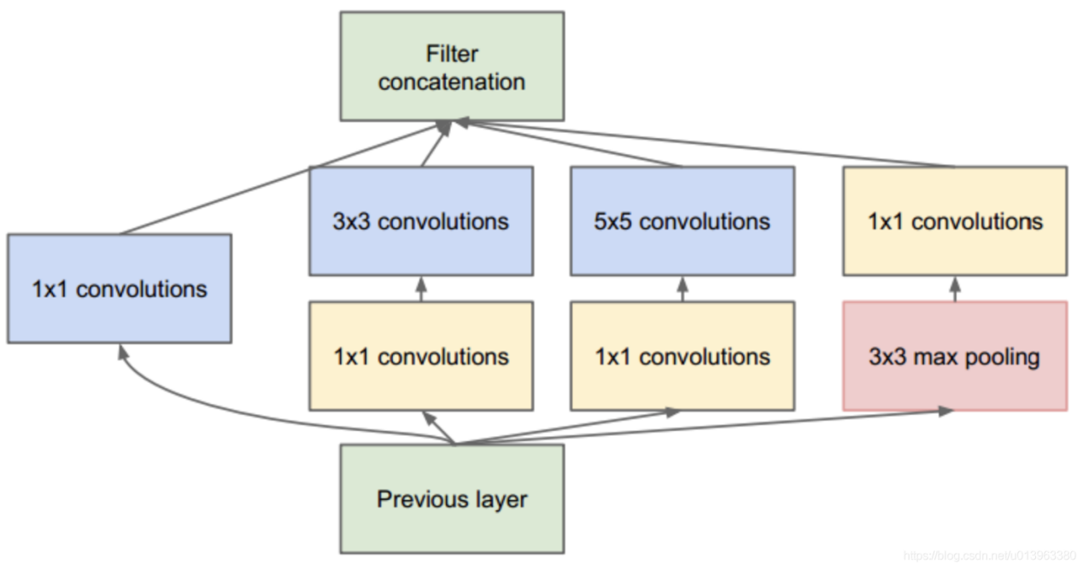
GoogLeNet
GoogLeNet is a CNN deep learning method proposed by Google that has a lower error rate than the VGGNet. Unlike the previous idea that the main goal is to deepen the depth of the network, GoogLeNet proposes a new structure called inception.
For a layer-by-layer construction network, the first task is to analyze the correlation statistics of the nearest layer, and according to the analysis results, the highly correlated cells are grouped into the same clusters to form the cells of the next layer, and connected to the cells of the previous layer. Also, in order to avoid the patchalignment issues, the filter sizes in the inception are 1x1, 3x3 and 5x5.
Excessive number of filters
A 1x1 operation precedes the 3x3 and 5x5 convolutions and follows the 3x3 pooling operation. The 1x1 convolution technique reduces filter count, reducing network size. Inception's 1x1 convolution function expands the network. This is GoogLeNet's foundation. The union of many Inceptions eventually forms GoogLeNet

Slide 9
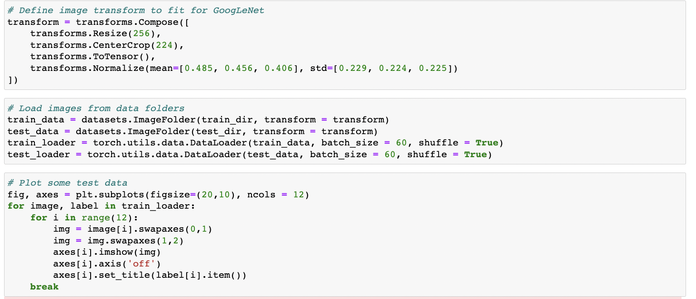
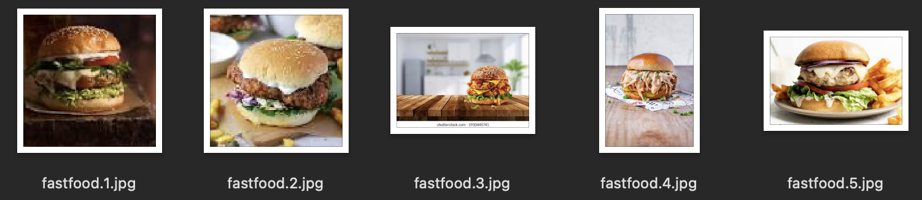
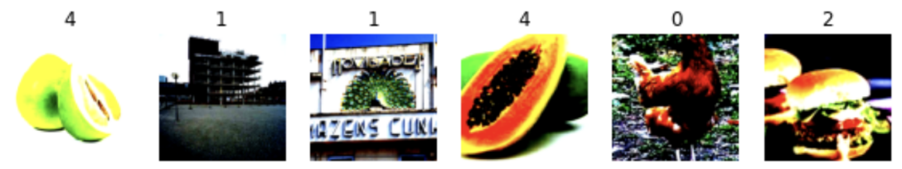
GoogLeNet
Because GoogLeNet has fixed requirements for image format, and in our dataset, the size and dimensions of our images are not uniform, so before training, we reproduce the standard image size and data representation required by GoogLeNet. The reproduced data is shown in the following figure.
data normalization

Slide 10
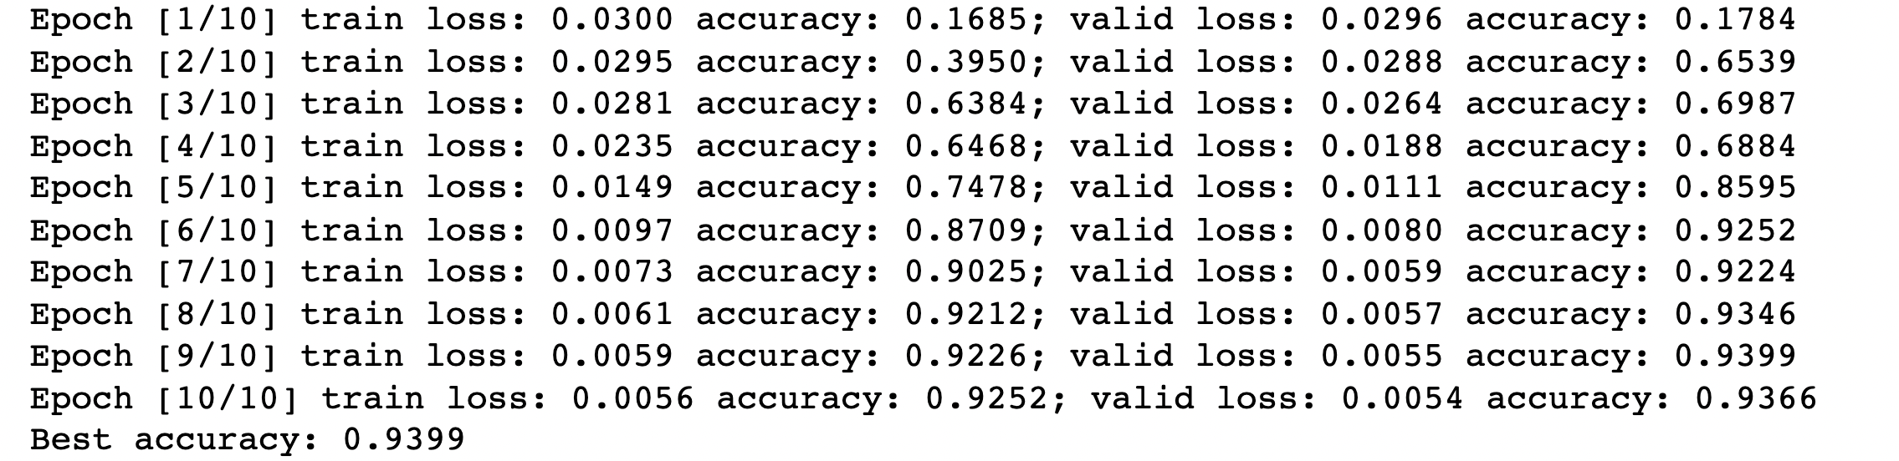
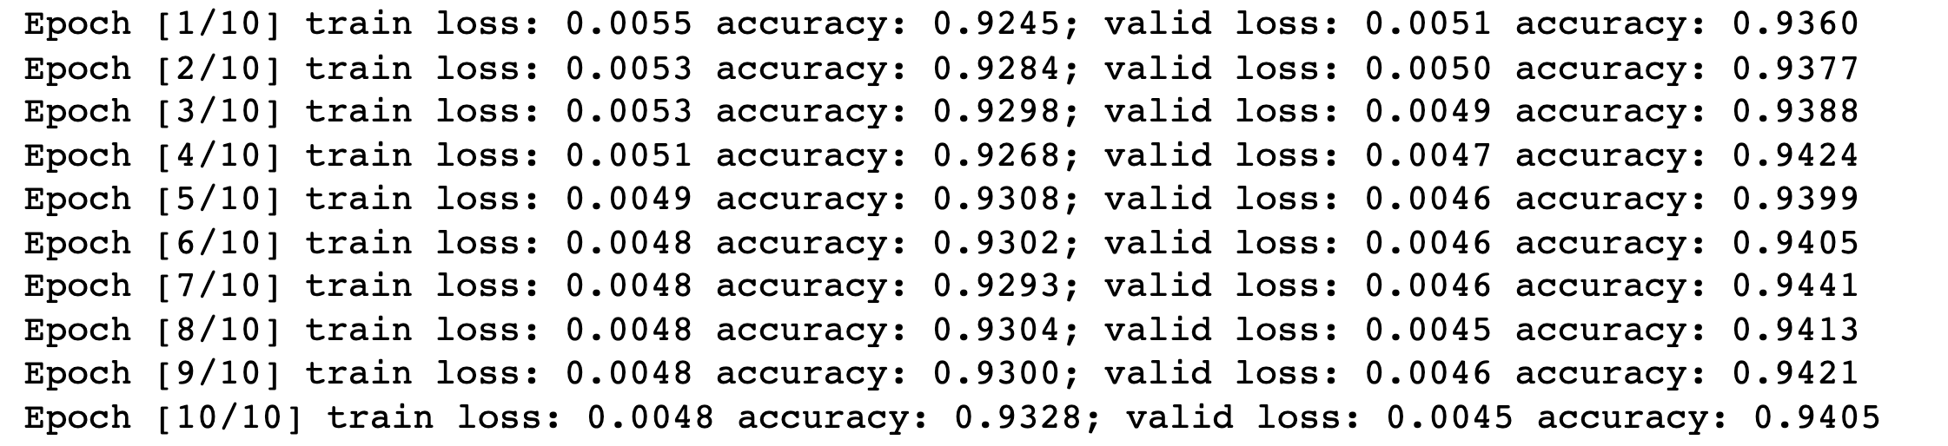
GoogLeNet
After the first training, we obtained the following results：
On the basis of the first training, the number of training sessions was doubled and the training was performed again, and the following results were obtained:
the accuracy of GoogLeNet

Slide 11
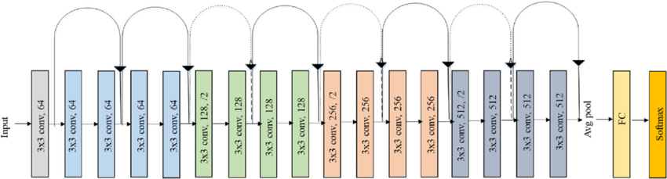
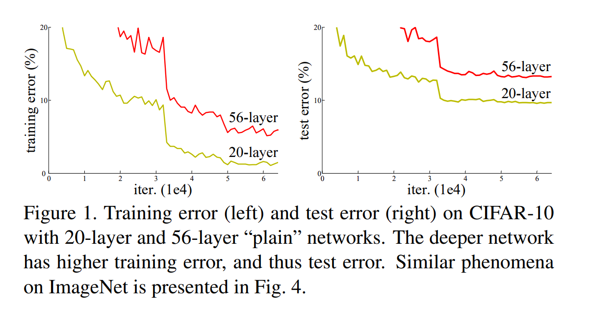
ResNet
Due to the widespread use of deep convolutional neural networks, the network's depth must be further increased in order to attain improved accuracy in people's traditional cognition. The development of residual neural network (ResNet), however, has disproved this notion. Based on Deep Residual Learning for Image Recognition from He et al, it is shown that there is a maximum threshold for the depth of traditional CNN models.
training error and test error on CIFAR - 10 with 10- layer and 56 -layer
18-layer residual network

Slide 12
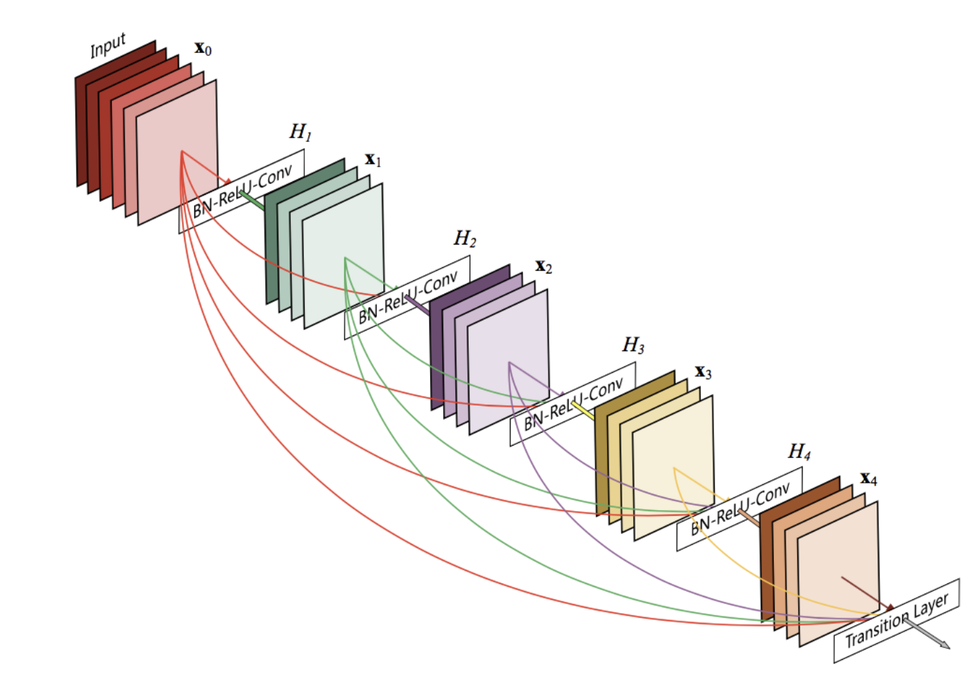
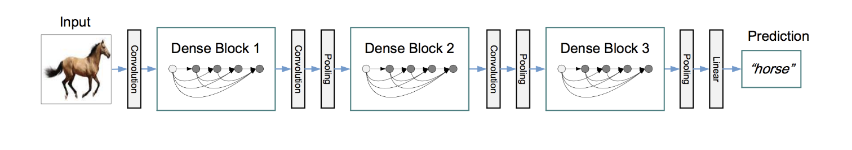
DenseNet
Dense Convolutional Network (DenseNet) is very similar to a ResNet with some-fundamental differences. ResNet is using an additive method that means they take a previous output as an input for a future layer, and in DenseNet takes all previous output as an input for a future layer as shown in the above image. With dense connection, fewer parameters and high accuracy are achieved compared with ResNet.
Advantages of the DenseNet:
Strong Gradient Flow: The error signal can be easily propagated to earlier layers more directly.
Parameter & Computational Efficiency: For each layer, number of parameters DenseNet has much smaller size than ResNet.
More Diversified Features: Since each layer in DenseNet receive all preceding layers as input, more diversified features and tends to have richer patterns.
Maintains Low Complexity Features: In DenseNet, classifier uses features of all complexity levels. It tends to give more smooth decision boundaries.
the structure of DenseNet

Slide 13
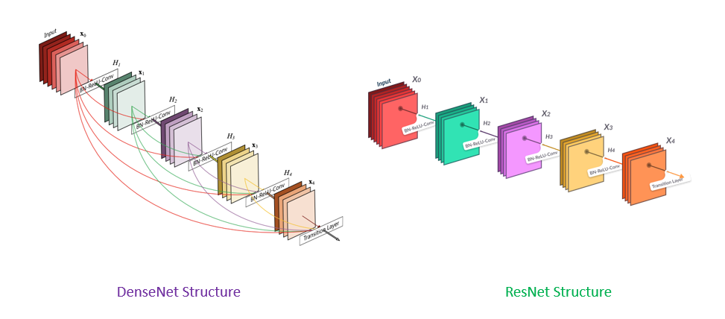
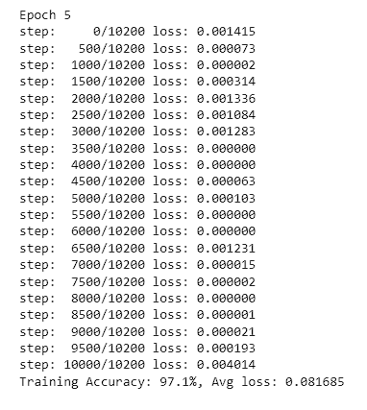
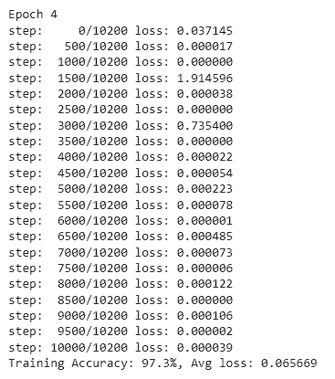
ResNet vs DenseNet
During model training, I divided the training data into 10200 pictures for training, 900 for validation and 900 for testing. And the pictures are all randomly scrambled and resized and normalized.
 | ResNet | DenseNet
Innovation | Residual learning shortcut connection Deepening the network without degradation | Dense shortcut connections Feature reuse Introduce transition layer
Stitching method | Element-wise add | Concatenate
Speed of training | Quick | Slow
Number of participants | More | Less
Comparison of the accuracy of the two models
Comparison of the two models

Slide 14
Evaluation
 | VGG | GoogLeNet | ResNet | DesnNet
Appearance time | 2014 | 2014 | 2015 | 2018
Number of layers | 19 | 22 | 152 | 121
Top-5 Error | 7.30% | 6.70% | 3.57% | 7.83%
Data Augmentation | + | + | + | +
Inception | - | + | - | +
Number of convolution layers | 16 | 21 | 151 | 120
Convolution kernel size | 3 | 7,1,3,5 | 7,1,3 | 7,1,3
Number of fully connected layers | 3 | 1 | 1 | 1
Dropout | + | + | - | -
Local Response Normailiztion | - | + | - | -
Batch Normaliztion | - | - | + | +
Comparison of four Popular Convolutional Neural Networks

Slide 15
Conclusion & Future Work
Conclusion
Future Work
Add comparison with ResNet152
Add comparison with DenseNet161
Add modifications for practical applications
Further fine-tuning
the actual test results are basically consistent with the theory
but there are also slight differences due to the test environment, differences in data set division, and other factors.

Slide 16
References
[1] A. Krizhevsky, I. Sutskever, and G. E. Hinton, “Imagenet classification with deep convolutional neural networks,” in Advances in neural information processing systems, 2012, pp. 1097-1105.
[2] G. Klambauer, T. Unterthiner, A. Mayr, and S. Hochreiter, “Self-Normalizing Neural Networks,” ArXiv e-prints, vol. 1706, Accessed on: June 1, 2017Available: http://adsabs.harvard.edu/abs/2017arXiv170602515K
[3] X. Glorot and Y. Bengio, “Understanding the difficulty of training deep feedforward neural networks,” in Proceedings of the Thirteenth International Conference on Artificial Intelligence and Statistics, 2010, pp. 249-256.
[4] S. Ioffe and C. Szegedy, “Batch Normalization: Accelerating Deep Network Training by Reducing Internal Covariate Shift,” ArXiv e-prints, vol. 1502, Accessed on: February 1, 2015Available: http://adsabs.harvard.edu/abs/2015arXiv150203167I
[5] C. Szegedy, V. Vanhoucke, S. Ioffe, J. Shlens, and Z. Wojna, “Rethinking the Inception Architecture for Computer Vision,” ArXiv e-prints, vol. 1512, Accessed on: December 1, 2015Available: http://adsabs.harvard.edu/abs/2015arXiv151200567S
[6] C. Szegedy, S. Ioffe, V. Vanhoucke, and A. A. Alemi, “Inception-v4, Inception-ResNet and the Impact of Residual Connections on Learning,” in AAAI, 2017, pp. 4278-428
[7] M. D. Zeiler and R. Fergus, “Visualizing and Understanding Convolutional Networks,” ArXiv e-prints, vol. 1311, Accessed on: November 1, 2013Available: http://adsabs.harvard.edu/abs/2013arXiv1311.2901Z
[8] K. Simonyan and A. Zisserman, “Very deep convolutional networks for large-scale image recognition,” arXiv preprint arXiv:1409.1556, 2014.
[9] M. Lin, Q. Chen, and S. Yan, “Network In Network,” ArXiv e-prints, vol. 1312, Accessed on: December 1, 2013Available: http://adsabs.harvard.edu/abs/2013arXiv1312.4400L
[10] C. Szegedy et al., “Going Deeper with Convolutions,” ArXiv e-prints, vol. 1409, Accessed on: September 1, 2014Available: http://adsabs.harvard.edu/abs/2014arXiv1409.4842S

